Slide 1
Microsoft Cloud for Financial Services Overview
Module 1
November 2021

Slide 2
Microsoft Cloud For Financial Services – Regional Availability
Wave 1 General Availability
November 1st , 2021
US
UK
January 2022
Canada
Early 2022
Regional Availability Roadmap will be published

Slide 3





The COVID-19 pandemic was a catalyst for change and shifting business priorities
Here’s what we’ve heard from the industry:
Customer engagement
Employee experience
Value
creation
Fraud protection
Security and compliance
Notes:
Slide title: The COVID-19 pandemic was a catalyst for change and shifting business priorities
Top of mind today is the way that the pandemic has shifted the industry.
We’ve heard from banks like you that you are looking for support with the following:
Customer engagement: Customers are leveraging digital engagement channels more than ever. This rise in adoption of digital banking products during the pandemic has driven banks to expedite their digital transformation agendas. In a recent Celent global research, 75% of bank respondents have seen budgets grow for digital banking enhancements for self service as well as assisted channels. Digital-forward banks are leading the way when it comes to investing in digital experiences for high-value offerings such as lending.
Employee experience: The pandemic swings have spurred the need to be flexible to adapt to changing work patterns. While banks have embraced digital tools for communications and collaboration, we hear there is more needed to help employees, especially those in the front office serving customers, become successful in their roles.
Value creation: Global interest rates hovering near zero pressures profitability with inflation as a concern. Banks like you are looking for opportunities to unlock value creation for long-term benefits and to lead with differentiation.
Fraud protection: In 2020, there were 393,207 reports of credit card fraud in the US. Account and purchase fraud not only affect consumers but also adversely impact the credibility and reputation of financial institutions. With fraud on the rise, banks are looking for new approaches to fraud protection.
Security and compliance: The industry is experiencing a level of regulatory scrutiny that is unprecedented in its intensity. Financial institutions that best manage their regulatory and compliance data will be on a path to stronger risk management and improved operational efficiency.
<click>

Slide 4




Microsoft Cloud for Financial Services
Trusted cloud to accelerate innovation for sustainable growth
Deliver differentiated customer experience
Empower employees through teamwork
Combat financial crime
Provide tools to help accelerate customer growth, profitability, and loyalty through more relevant and personalized interactions along with deeper customer insights
Help fuel employee productivity, enhance process efficiencies, and strengthen customer connections through automation, collaboration, and communications
Help enhance customer experience, lower account fraud, and boost profitability
Built on a foundation of:
Trust, security, and compliance
Interoperability
At Microsoft we are focused on trust, and we adhere to security and privacy standards to place you in control over security, encryption, and governance
Help ease interoperability and unify data with an industry data model and connectors to help accelerate insights and business workflows
Notes:
Slide title: Microsoft Cloud for Financial Services
In response to your focus on cloud services, Microsoft has prioritized developing services specific to the industry.
Today, I’m excited to share the Microsoft Cloud for Financial Services, built on a foundation of privacy, security, and regulatory compliance across Microsoft and the partner ecosystem.
As with all our offerings, here we’re focused on trust, and we adhere to security and privacy standards to place you in control over security, encryption, and governance.
In addition, the Cloud for Financial Services is built on an industry data model which helps ease interoperability and unifies data to help accelerate insights and business workflows.
Built on this essential foundation, the Cloud for Financial Services helps manage data to deliver differentiated experiences, empower employees, and help combat financial crime:
First, we focus on customer experience: We help you provide tools to help accelerate customer growth, profitability, and loyalty through more relevant and personalized interactions along with deeper customer insights
Next, empowering employees through teamwork: We help you fuel employee productivity, enhance process efficiencies, and strengthen customer connections through automation, collaboration, and communications
Last but not least, combatting financial crime: With this, we help you enhance customer experience, lower account fraud, and boost profitability
<click>

Slide 5



Microsoft Cloud for Financial Services Capabilities for Retail Banking
Customer onboarding Provide customers with easy-access loan apps and self-service tools, streamlining the loan process to help enhance customer experience and loyalty
Collaboration manager Enable automation, collaboration, and communications to help accelerate lending processes, minimize errors, and enhance customer experience
Deliver Differentiated Customer Experience and Empower Employees
Unified customer profile Help tailor customer experiences via a comprehensive view of the customer's financial situation
Banking customer engagement Help personalize customer interactions with relevant financial information to accelerate time to resolution
Security and Compliance
Combat Financial Crime
Risk assurance and support
White glove service to support risk, audit, and compliance teams in addressing financial services regulatory compliance, cybersecurity, and privacy
Account protection
Help prevent fraudulent digital account creation and account takeover
Regulatory compliance assessments
Assess, monitor, and help improve compliance posture with global, regional, and industry regulations and standards
Purchase protection
Help provide a differentiated experience for merchants to improve revenue and retention
Industry Specific
Data model and connectors
Partner ecosystem
Microsoft Cloud
Notes:
Slide title: Microsoft Cloud for Financial Services
Now let's take a closer look at the capabilities around the value chain.
We start with delivering a differentiated customer experience and empowering employees. We recognize that these are intertwined, so we’ve created capabilities that are just as effective for each.
First, we have unified customer profile. With this capability, your employees have a comprehensive view of the customer which helps them tailor customer experiences.
Next, we have customer onboarding. Customer onboarding provides customers with easy-access loan apps and self-service tools, streamlining the loan process to help enhance customer experience and loyalty.
Collaboration manager is another key capability. It enables automation, collaboration, and communications to help accelerate lending processes, minimize errors, and enhance customer experience
Finally, we have banking customer engagement, which helps personalize customer interactions with relevant financial information to accelerate time to resolution.
Up next, we focus on combatting financial crime. We have two connected capabilities here: The first is account protection, which helps prevent fraudulent digital account creation and account takeover.
Next, we have purchase protection which helps provide a differentiated experience for merchants to improve revenue and retention.
Our offering wouldn’t be complete without robust security and compliance capabilities.
We offer regulatory compliance assessments, which are a must-have in this highly regulated industry. This capability enables you to assess, monitor, and help improve compliance posture with global, regional, and industry regulations and standards.
We also offer risk assurance and support, a white glove service to support risk, audit, and compliance teams in addressing financial services regulatory compliance, cybersecurity, and privacy.
As I mentioned, these capabilities are built on a few key foundational elements that are tailored to the financial service industry. The first is our data model and connectors. This is what enables the connection between our capabilities and your data and ensures interoperability of our solutions with your solutions and partner solutions.
That brings me to my next point: the power of the Microsoft Cloud for Financial Services doesn’t stop with our first-party technologies and solutions. Our extensive ecosystem of partners extends the cloud’s capabilities even further, ensuring you can find a solution to fit your needs that builds on our technologies.
And beneath it all is the Microsoft Cloud. You can depend on our trusted cloud services to power all these capabilities.
<click>

Slide 6
Customer and employee experience
“With our Microsoft-based solution, our relationship managers now have the tool they need to serve clients even more successfully, build and maximize relationships, and identify and act on new opportunities.
— Anneke Broere
Business Owner of ClientLink at Rabobank
Notes:
Slide title: Customer and employee experience
We’ll start with the capabilities driving customer and employee experience.
<click>
Source: Microsoft Customer Story-Banco Sabadell allies with Microsoft to offer more personalized and agile service to its customers with Dynamics 365 - https://customers.microsoft.com/es-es/story/843645-sabadell-bank-markets-dynamics365-en-spain

Slide 7

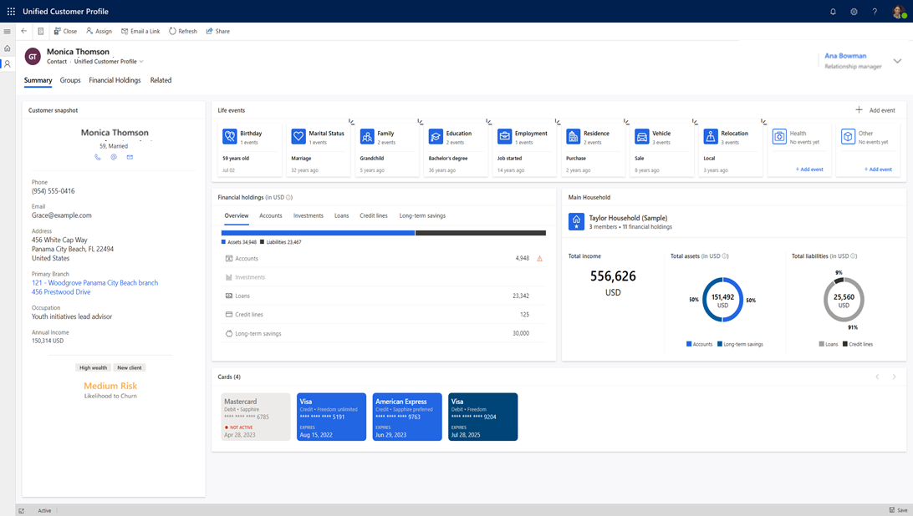
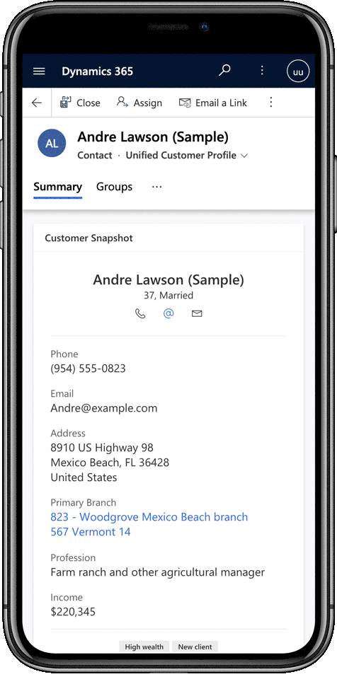
Unified customer profile
Help tailor customer experiences via a comprehensive view of the customer's financial situation
Customer insights
Financial details, such as life events and household information, help create a single customer view
Summary view
Insights drawn from unified customer information help drive better customer outcomes
Banking segments
Segmentation helps you focus on the right customers and opportunities to increase success
Churn risk
Adaptive AI helps anticipate customer abandonment so you can work proactively to reduce risk of churn
Notes:
Slide title: Unified customer profile
First up: Unified customer profile. This capability helps tailor customer experiences with a comprehensive view of the customer's financial situation and preferences.
With a unified customer profile, banks like yours can take advantage of cross-sell/up-sell opportunities, helping to increase customer lifetime value and loyalty.
The tools you need?:
Customer Insights: Financial details such as life events and household information come together to help create a single customer view. You can accomplish this with the help of Customer Insights, our customer data platform, which helps connect tools across your bank using a wide range of connectors. It has the functionality to mix, match, and merge to help you can unify customer information across these tools. It also allows you to add AI models so you can enrich this data.
Summary view – Capture a single, unified yet intuitive view of the customer’s financial situation to help you quickly know customers and personalize their experiences
Banking segments – By segmenting customers into groups that share similar values, financial standing etc., we help you focus on the right customers and opportunities to increase success
Churn risk – Adaptive AI helps you understand the customer’s likelihood to churn to inform decisions, empowering agents to take pre-emptive actions and reduce risk of churn
<click>

Slide 8
Unified customer profile
Combine customer and behavioral data to help anticipate opportunities and churn with pre-built AI for financial services
Customer 360 unlocked
Centralize your customer data in a single place via Microsoft Dataverse and the industry data model
Benefit from a data-first experience that helps bring together financial details, life events, and household information into a single view
Leverage 500+ built-in connectors to bring in your customer-relevant data and information
Build custom applications leveraging our controls with low- and pro-code tools
Build custom connectors to nearly any system of record or data source and integrate apps and data directly
Relationship manager productivity
Help drive better customer outcomes with insights drawn from unified customer information
Leverage a purpose-built banking churn model to help understand churn risk at a glance
Leverage our existing banking segments and bring in your own rules and definitions
Offer the most accurate and important customer information to your relationship managers to improve the customer experience
Dependencies: Power Apps, Dynamics 365 Customer Insights
Notes:
Slide title: Unified customer profile
Unified customer profile combines customer and behavioral data to help anticipate opportunities and churn with pre-built AI for financial services.
With a unified customer profile, banks like yours can help personalize experiences and take advantage of cross-sell/up-sell opportunities, increasing customer lifetime value and loyalty.
Unified customer profile unlocks a 360-degree view of the customer. You can:
Centralize your customer data in a single place via Microsoft Dataverse and the industry data model
Benefit from a data-first experience that brings together financial details, life events, and household information into a single view
Leverage 500+ built-in connectors to bring in all your customer relevant data and information
Build custom applications leveraging our controls with low- and pro-code tools
Build custom connectors to nearly any system of record or data source and integrate apps and data directly
It also enhances relationship manager productivity:
Help drive better customer outcomes with insights drawn from unified customer information
Leverage a purpose-built banking churn model to help understand churn risk at a glance
Leverage our existing banking segments and bring in your own rules and definitions
Offer the most accurate and important customer information to your relationship managers for an unparalleled customer experience
<click>

Slide 9
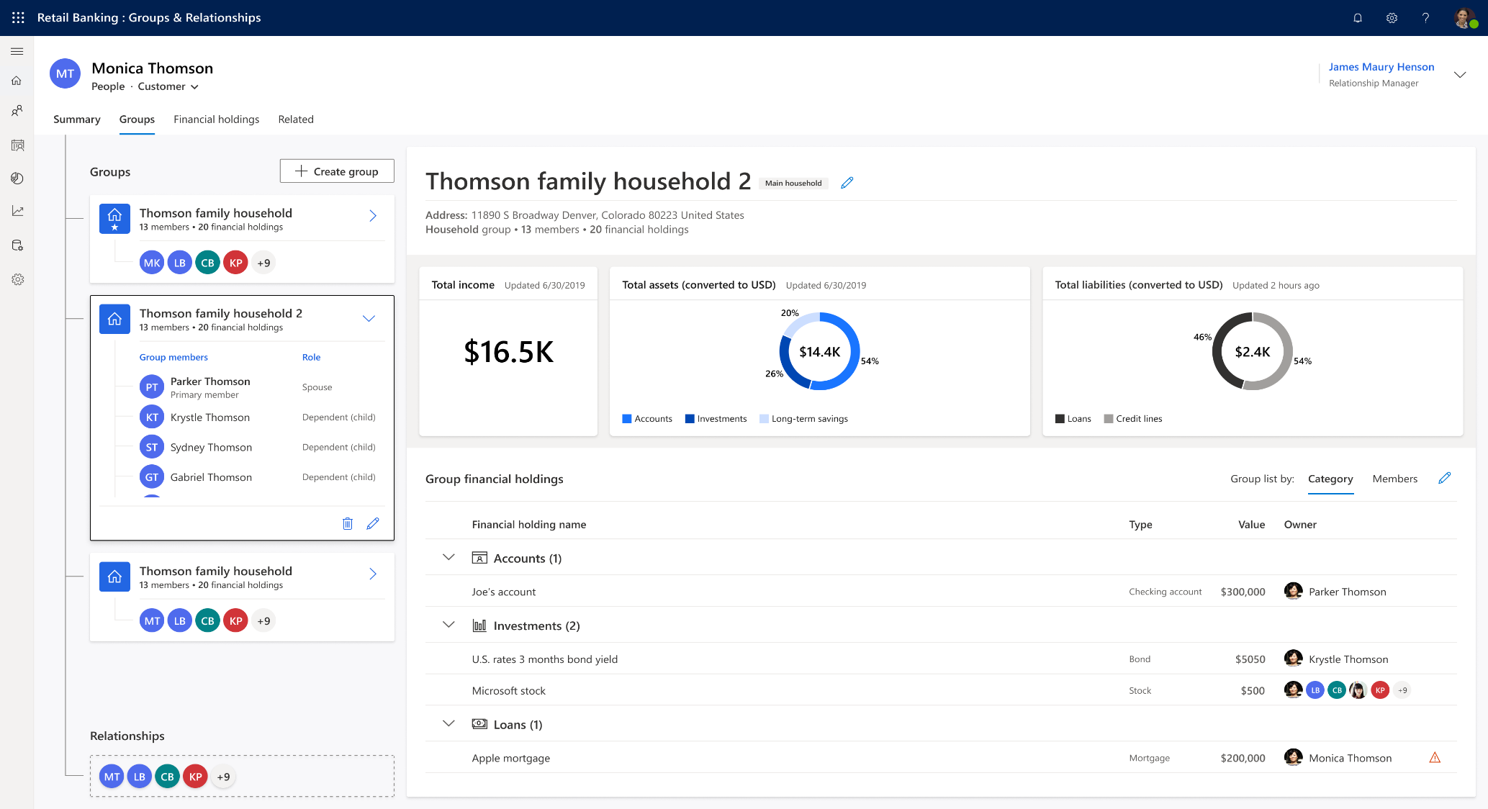
Unified customer profile
Customer insights
Financial holding
Empower bank agents to quickly understand wallet share, total assets and liabilities, and key flags related to holdings to help surface opportunities and deepen relationships
Life events
Offer at-a-glance view of life milestones to help identify financial opportunities, create personalized offers, and deliver consistent engagement experiences across bank agents
Connections
Help bank agents understand the "impact and influence" of their customers, the potential financial strength of the customer, based on their groups and relationships, e.g., familial connections
Dependencies: Power Apps, Dynamics 365 Customer Insights
Notes:
Slide title: Unified customer profile
By unifying customer data, this capability offers powerful customer insights. These include:
Financial holding: Empower bank agents to quickly understand wallet share, total assets and liabilities, and key flags related to holdings to surface opportunities and deepen relationships
Live events: Offer at-a-glance view of life milestones to help identify financial opportunities, create personalized offers, and deliver consistent engagement experiences across bank agents
Connections: Help bank agents understand the "impact and influence" of their customers, the potential financial strength of the customer, based on their groups and relationships, e.g., familial connections
<click>

Slide 10
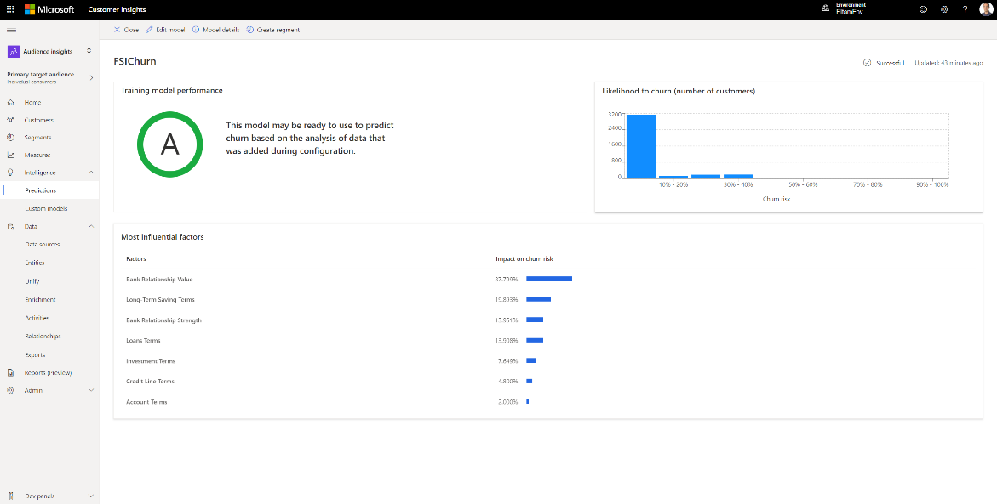

Unified customer profile
Banking churn risk
Churn model tailored for retail banking
Help predict the probability of customers leaving the bank, via banking-specific considerations. This enables a proactive approach for identifying and retaining customers via relevant incentives and personalized customer service
Configurable to meet specific needs
Easily update the data model without needing a data scientist using churn data model configuration
Built atop the industry data model
Leverage the same industry data model used across Microsoft Cloud for Financial Services capabilities to offer AI-powered insights within the application layer
Dependencies: Power Apps, Dynamics 365 Customer Insights
Notes:
Slide title: Unified customer profile
Key to Unified Customer Profile is the banking churn risk model:
Churn model tailored for retail banking: Help predict the probability of customers leaving the bank, via retail banking-specific considerations. This enables a proactive approach for identifying and retaining customers via relevant incentives and personalized customer service
Configurable to meet specific needs: Churn data model configuration is available within Customer Insights. You can easily update the data model without the help of a data scientist
Built atop the industry data model: Leverage the same industry data model used across Microsoft Cloud for Financial Services capabilities to offer AI-powered insights within the application layer
<click>

Slide 11
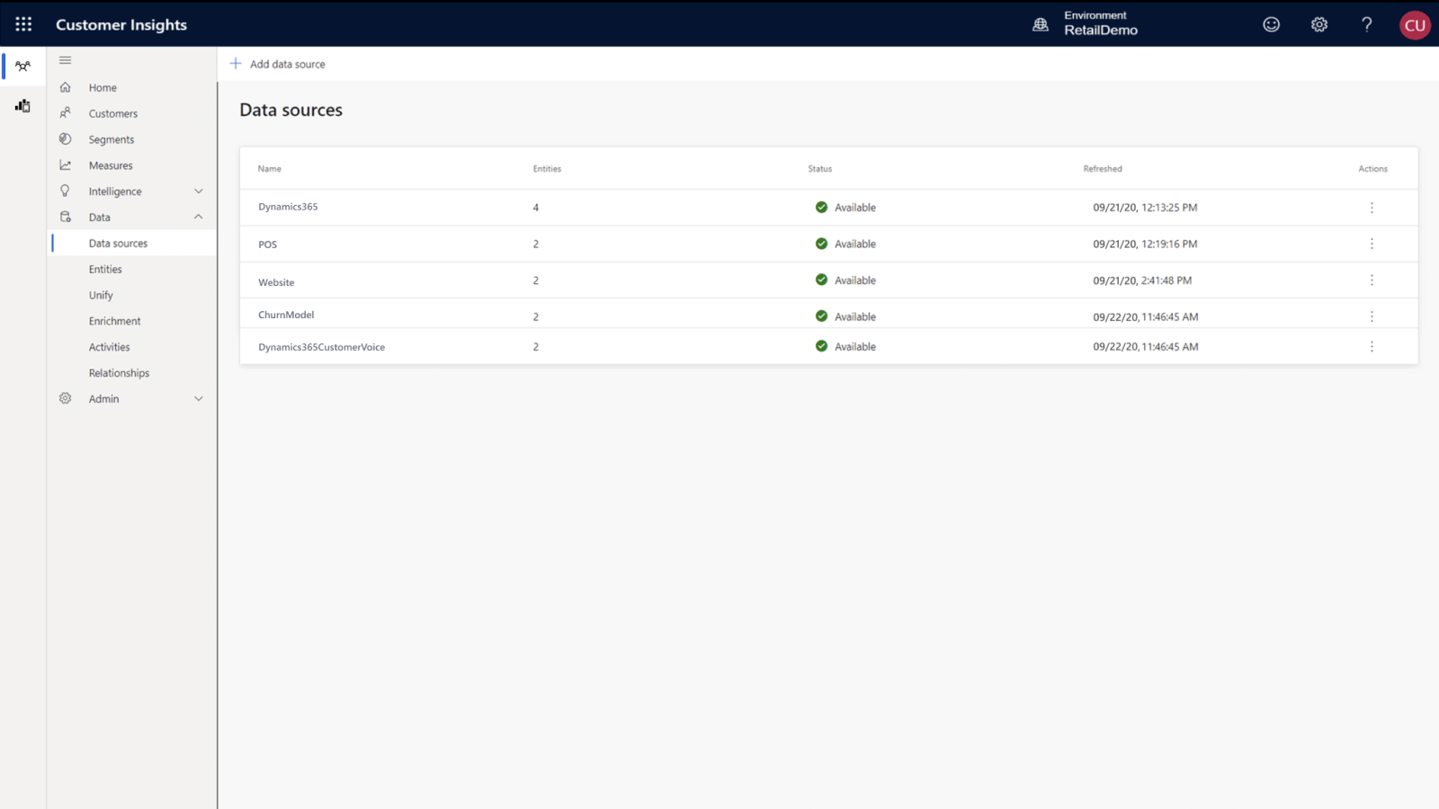
Unified customer profile
Dynamics 365 Customer Insights
Bring together customer data with prebuilt connectors
Ingest transactional, behavioral, and demographic data in real time for the most up-to-date view of your customers via more than 500+ built-in connectors
Streamline data standardization
Reconcile conflicting data and resolve customer identities using map, match, and merge to create comprehensive profiles
Enrich profiles with interests and preferences
Gain a single view of the customer with proprietary audience intelligence from Microsoft Graph and with industry enrichment sources
Dynamics 365 Customer Voice
Augment profiles with customer feedback, with segments based on customer satisfaction that help keep track of customer attitudes as well as tailor experiences to improve or sustain them over time
Dependencies: Power Apps, Dynamics 365 Customer Insights
Notes:
Slide title: Unified customer profile
Essential to Unified Customer Profile is Dynamics 365 Customer Insights:
Bring together customer data with prebuilt connectors: Ingest transactional, behavioral, and demographic data in real time for the most up-to-date view of your customers
Streamline data standardization: Reconcile conflicting data and resolve customer identities using map, match, and merge to create comprehensive profiles
Enrich profiles with interests and preferences: Gain a single view of the customer with proprietary audience intelligence from Microsoft Graph and with industry enrichment sources
Dynamics 365 Customer Voice: Augment profiles with customer feedback, with segments based on customer satisfaction that help keep track of customer attitudes as well as tailor experiences to improve or sustain them over time
<click>

Slide 12
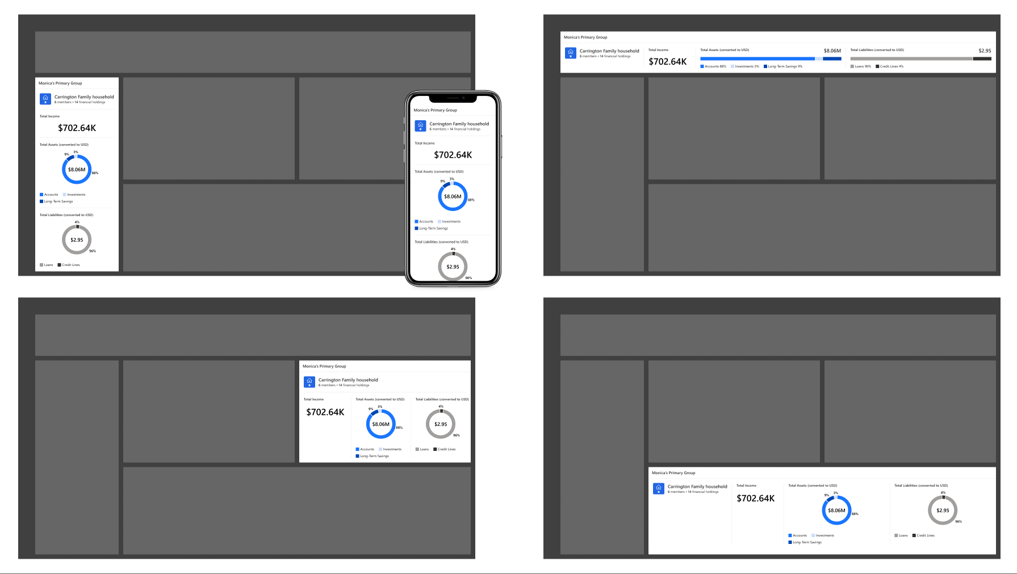
Unified customer profile
Extensibility
Componentization
Flexibly leverage components and add your own
Embed your processes
Bring your business processes by building custom applications leveraging our controls with low- and pro-code tools
Dependencies: Power Apps, Dynamics 365 Customer Insights
Notes:
Finally, you can extend unified customer profile to your own business processes:
Componentization: Flexibly leverage components and add your own
Embed your processes: Bring your business processes by building custom applications leveraging controls available in UCP with low- and pro-code tools
Next, let’s look at what powers unified customer profile.
<click>

Slide 13
Unified customer profile
Reference architecture
Unified customer profile
D365 Customer Insights
Power Apps
Unified customer profile app
Banking Customer Intelligence
Financial Services Segments
Financial Services Models (Financial Services Churn)
Financial Services Measures
Core Retail Banking Controls
Customer snapshot
Connections (Groups & Relationships)
Life events
Financial holdings
Dataverse
Financial Services Core Retail Banking Plugins
Financial Services CI Entities
Key
CI Data Store
Industry Data Model
Microsoft products
Financial services common DM
Retail Banking Entities
Common Data Model
Capability components
Bank Environment
Bank environment
Bank Schema 2 Financial Services CDM
Non-Customer Experience optional data
Customer Experience data (CIF+)
Additional Bank data sources
Banking Core Compute
Notes:
Slide title: Unified customer profile
[Seller guidance: Walk through the architecture starting at the bottom and answer any questions the customer has.]
<click>

Slide 14
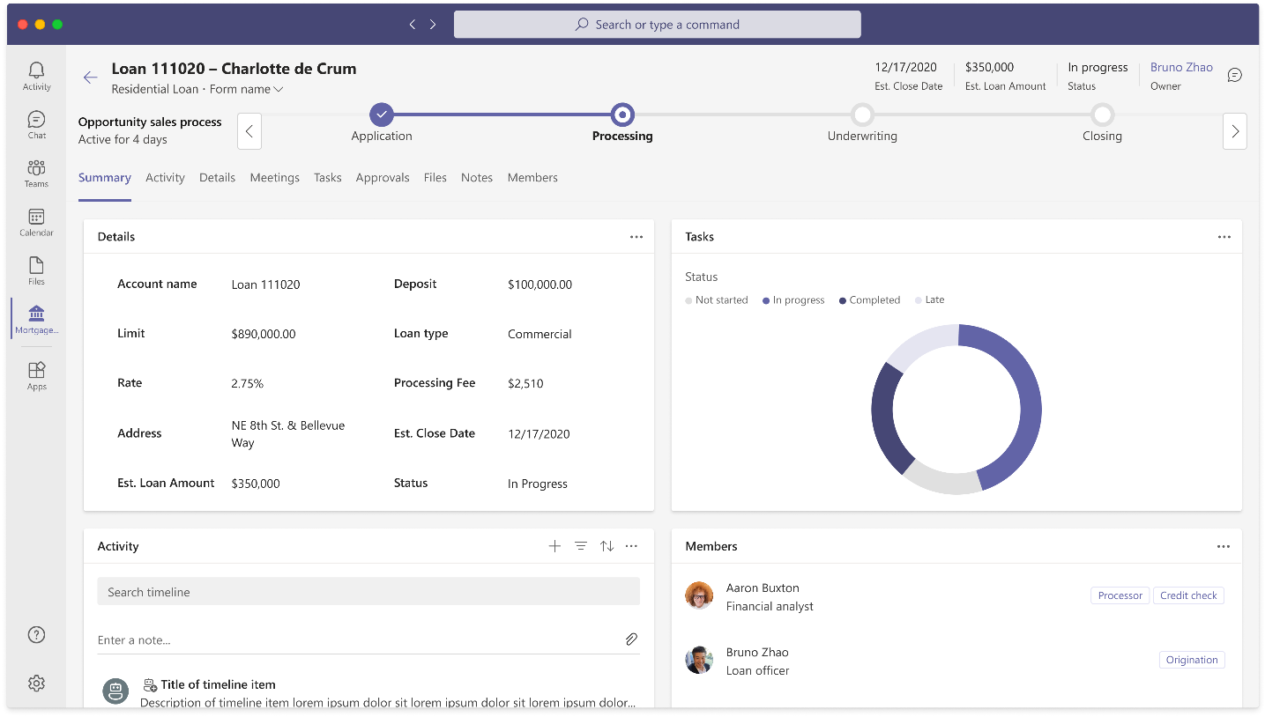
Collaboration manager
Transform lending workflows to help improve productivity, unlock value creation, and enhance customer experience
Lending automation
Intelligent tools help orchestrate lending processes and streamline operations
Cross-team collaboration
Intelligent dashboards help empower teams to collaboratively manage lending volume and centralize task and file management
Communications
Communications features help support customers virtually while meeting security and compliance needs
Public preview edition
Notes:
Slide title: Collaboration manager
Next, we have Collaboration manager. Collaboration manager is designed to help banks seamlessly bring collaboration into their lending workflows, improving process orchestration from front office to back office, and facilitating omnichannel communications with customers. Collaboration manager helps improve organization and employee productivity, unlock value creation, and enhance customer experience.
Here are a few highlights:
Lending automation: Intelligent tools help orchestrate lending processes and streamline automation. They aggregate data from existing systems using pre-built connectors and you can customize using low- and pro-code tools
Cross team collaboration: Intelligent dashboards help empower teams to collaboratively manage lending volume and centralize task and file management to enhance productivity
Communications: Communications features help support customers virtually while meeting security and compliance needs
<click>

Slide 15
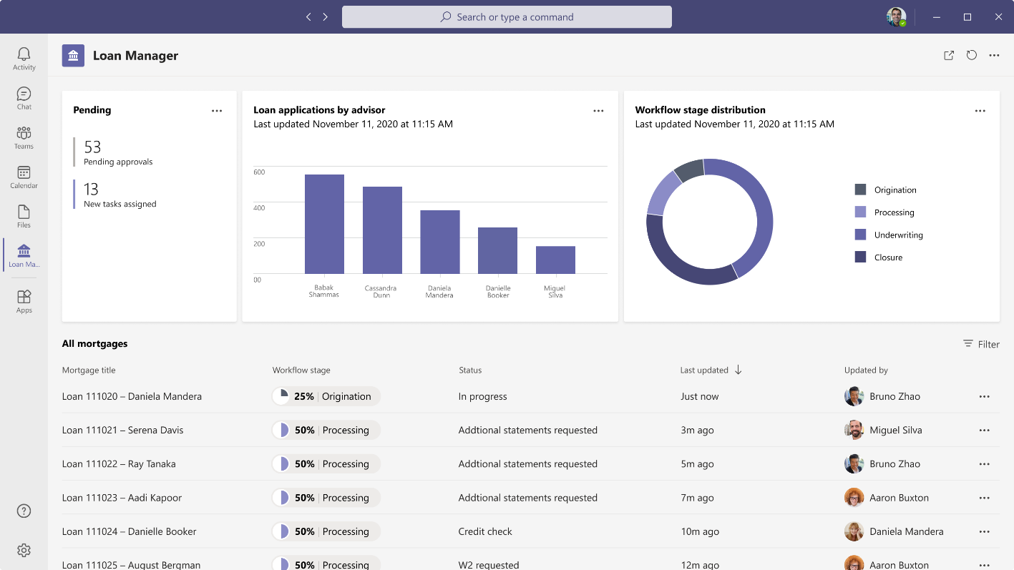
Collaboration manager
Automate lending processes, help foster internal collaboration, and facilitate omnichannel communications with customers
Process orchestration
Create flows with Power Automate triggered right from your Microsoft Teams data
Use low and pro-code development tools to ideate, test, and deploy workflows
Save costs and accelerate innovation with intelligent bots and robotic process automation (RPA)
Data aggregation
Centralize your data via Microsoft Dataverse and the industry data model
Leverage 500+ built-in connectors to help bring your content, tools, and apps into the Teams workspace
Build custom connectors to nearly any system of record or data source and integrate apps and data directly into Teams
Centralized task management
Start a list from scratch or save time with pre-built templates in Lists
Manage teams' tasks from Planner and individual tasks from To Do
Assign specific tasks to individuals or teams and easily track actions
Public preview edition
Dependencies: Teams, Power Apps, Azure AD B2C, Bookings | Recommended: Partner solutions from Adobe Sign and DocuSign
Notes:
Slide title: Collaboration manager
Collaboration manager is designed to help banks automate lending processes, help foster internal collaboration, and facilitate omnichannel communications with customers. Collaboration manager helps enhance organization and employee productivity, unlock value creation, reduce risk, and enhance customer experience.
Collaboration manager provides technology and features that enable 3 key areas for loan teams: automation, collaboration, and communication. Let’s talk about automation first.
Process orchestration
Create flows with Power Automate triggered right from your Microsoft Teams data
Use low and pro-code development tools to ideate, test and deploy workflows
Save costs and accelerate innovation with intelligent bots and RPA
Data aggregation
Centralize your data in a single place via Microsoft Dataverse and the industry data model
Leverage 500+ built-in connectors to help bring your content, tools, and apps into the Teams workspace
Build custom connectors to nearly any system of record or data source and integrate apps and data directly into Teams
Centralized task management
Start a list from scratch or save time with pre-built templates in Lists
Manage teams' tasks from Planner and individual tasks from To Do
Assign specific tasks to individuals or teams and easily track actions
<click>

Slide 16
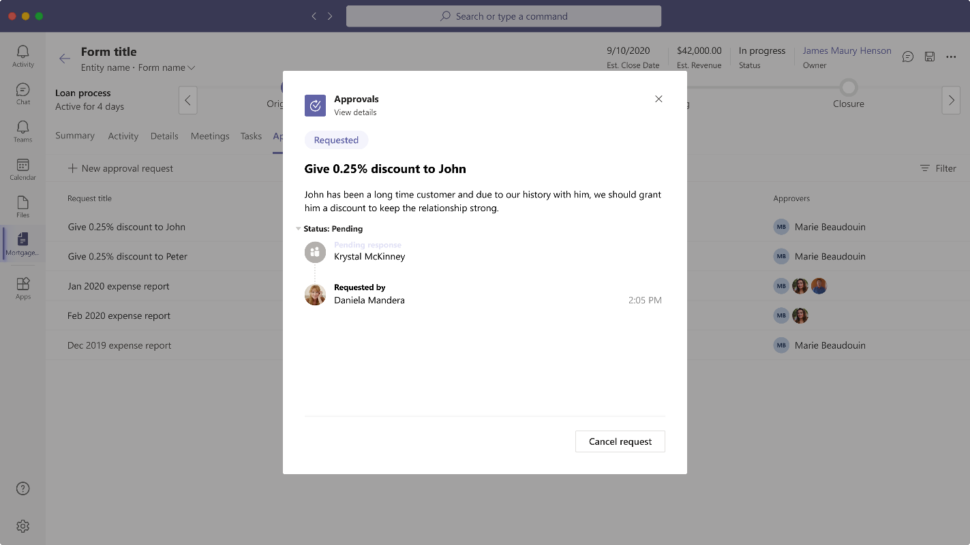
Collaboration manager
Automate lending processes, help foster internal collaboration, and facilitate omnichannel communications with customers
Document management
Ingest and store customer loan documents in SharePoint or third-party document repositories
Collaborate on documents, assign tasks, and route for approval
Approval management
Create, manage, share, and act on approvals across your structured and unstructured systems from the Approvals hub in Teams
Leverage integration with Adobe Sign and DocuSign for electronic signatures on loan documents, including Live Signing and notarization
Public preview edition
Dependencies: Teams, Power Apps, Azure AD B2C, Bookings | Recommended: Partner solutions from Adobe Sign and DocuSign
Notes:
Slide title: Collaboration manager
Collaboration manager enables cross-organizational collaboration with the following features:
Document management
Ingest and store customer loan documents in SharePoint or third-party document repositories
Collaborate on documents, assign tasks, and route for approval
Approval management
Create, manage, share, and act on approvals across your structured and unstructured systems from the Approvals hub in Teams
Leverage integration with Adobe Sign and DocuSign for electronic signatures on loan documents, including Live Signing and notarization
<click>

Slide 17
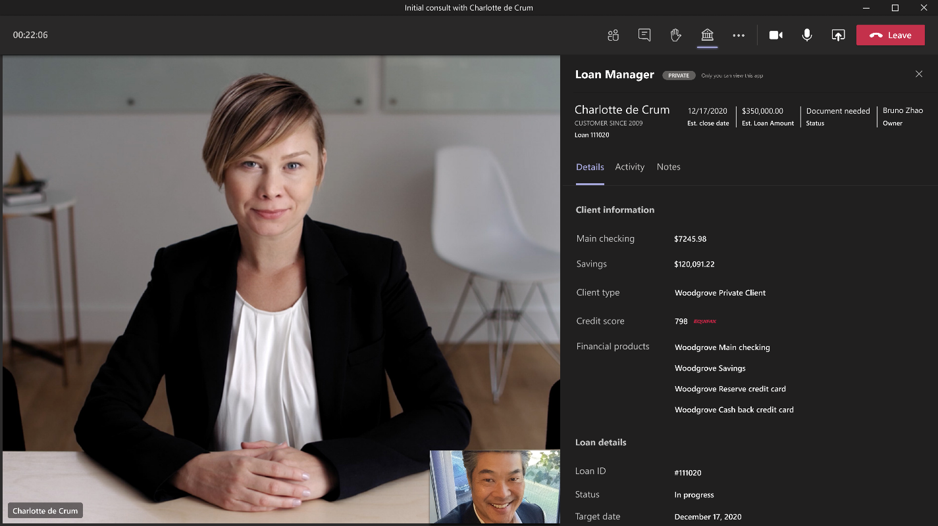
Collaboration manager
Automate lending processes, help foster internal collaboration, and facilitate omnichannel communications with customers
Appointment scheduling and booking
Use the web-based booking calendar of Bookings and integration with Outlook to help optimize staff calendar’s and empower customers with flexibility for scheduling
Conduct virtual appointments via Teams and manage day-to-day scheduling via the Bookings app in Teams
Real-time communications
Help drive robust bank-to-customer and front-to-back-office digital communications with Teams
Embed customer information from CRM systems (Dynamics 365 and third-party) directly into Teams channels, meetings, chats, etc.
Utilize compliance capabilities with recording and integration with multiple third-party and compliance systems
Secure messaging
Leverage priority notifications, tagging capabilities, and read receipts
Enable federated messaging within Teams to connect with authorized external users
Automatically escalate messages to another user when an intended recipient is unavailable or out of office
Public preview edition
Dependencies: Teams, Power Apps, Azure AD B2C, Bookings | Recommended: Partner solutions from Adobe Sign and DocuSign
Notes:
Slide title: Collaboration manager
Collaboration manager facilitates improved communications with the following features:
Appointment scheduling and booking
Use the web-based booking calendar of Bookings and integration with Outlook to help optimize staff calendar’s and empower customers with flexibility for scheduling
Conduct virtual appointments via Teams and manage day-to-day scheduling via the Bookings app in Teams
Real-time communications
Help drive robust bank-to-customer and front-to-back-office digital communications with Teams
Embed customer information from CRM systems (Dynamics 365 and third-party) directly into Teams channels, meetings, chats, etc.
Utilize compliance capabilities with recording and integration with multiple third-party and compliance systems
Secure messaging
Leverage priority notifications, tagging capabilities, and read receipts
Enable federated messaging within Teams to connect with authorized external users
Automatically escalate messages to another user when an intended recipient is unavailable or out of office
To bring collaboration manager to life, financial institutions are required to have Microsoft Teams, Power Apps, Azure AD B2C, and Bookings. To unlock the breadth of benefits, we recommend deploying partner solutions from Adobe eSign and DocuSign for electronic signature abilities integrated within collaboration manager.
<click>

Slide 18



Collaboration manager
First-party
Microsoft Teams
Reference architecture
Collaboration Manager (Model Driven App)
Microsoft Dataverse
Industry Toolkit
Banking Data Model
Microsoft Graph
Partner
Integration service
Connectors
Customer
System of Record
Public preview edition
Key
Teams
Partner
Customer
Notes:
Slide title: Collaboration manager
[Seller guidance: Note - Dynamics 365 applications sit at the integration service level or sometimes the system of record itself. Integration with Customer Onboarding is possible through this integration service.]
<click>

Slide 19
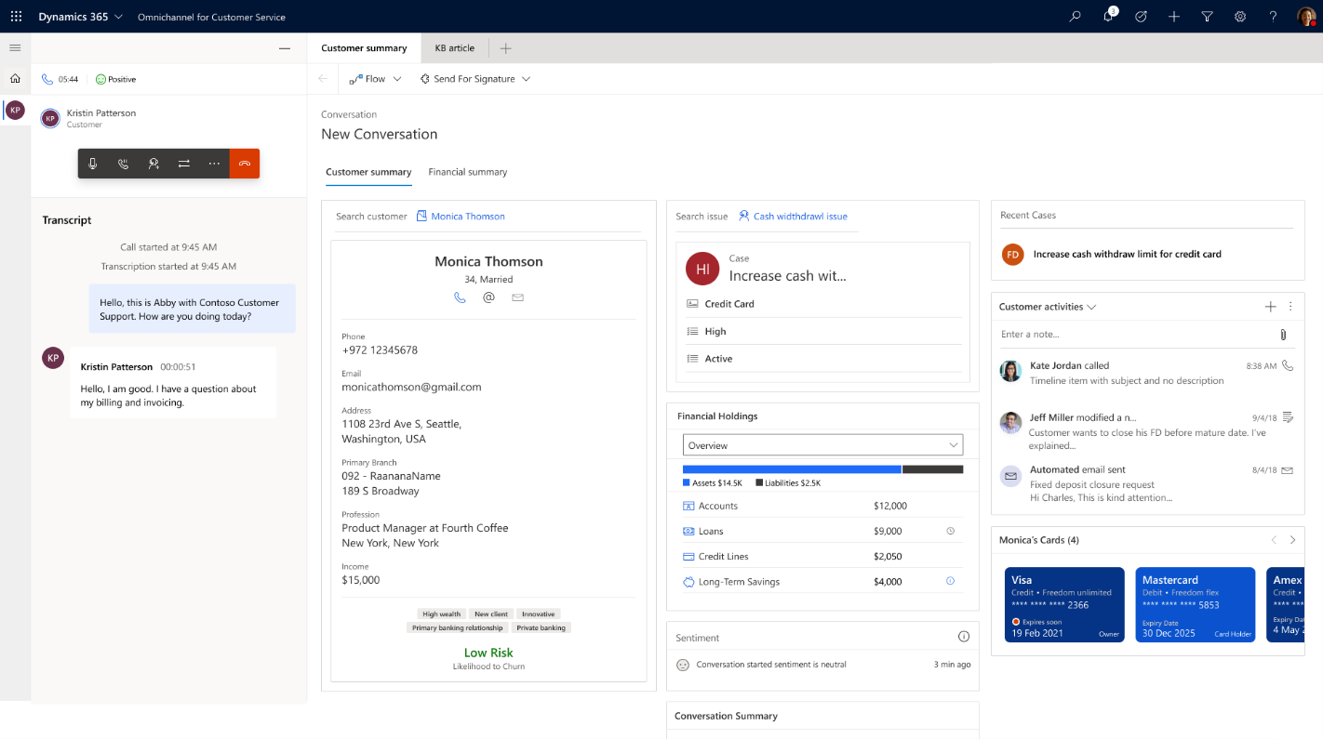
Banking customer engagement
Help personalize customer interactions with relevant financial information to accelerate time to resolution
Personalization
Financial understanding helps personalize interactions for meaningful engagement
Customer service center
Unified customer profiles help empower service agents with the right information to drive towards quick resolution
Omnichannel experiences
A unified agent desktop helps deliver consistent, connected experiences across channels including voice, messaging, and social
Public preview edition
Notes:
Slide title: Banking customer engagement
Effectively engaging with customers on their preferred channel has heightened importance with many in-person interactions being replaced by digital ones.
With our banking customer engagement capabilities, we help you personalize customer interactions. You can help empower employees with deep customer understanding to engage with customers on their preferred channel in a meaningful way, while intelligently managing their journeys across channels, to reduce churn and time to resolution.
Here are a few key features that enable banks to seamlessly manage the full customer interaction journey:
Personalization: Help personalize interactions with financial understanding for meaningful engagement
Customer service center: Help empower service agents with the right information to drive towards quick resolution
Omnichannel experiences: Help reduce churn by facilitating a personalized and continuous experience across channels (including voice, chat, SMS, Facebook Messenger, WhatsApp, WeChat, Twitter DM, and Line)
<click>

Slide 20
Banking customer engagement
Help personalize customer interactions with relevant financial information to accelerate time to resolution
Financial information in the flow
Inform customer conversations with an easily available financial summary to help drive better customer engagements
Help understand the risk of churn at a glance powered by a purpose-built banking churn model
Leverage our existing banking segments and bring in your own rules and definitions
Accelerate and optimize customer service
Offer easy access to financial holding details to personalize customer engagements
Deliver a full customer view within Omnichannel, arming service providers with relevant information at their fingertips
Public preview edition
Dependencies: Dynamics 365 Customer Service with Omnichannel | Recommended: Dynamics 365 Customer Insights
Notes:
Slide title: Banking customer engagement
Our banking customer engagement capability helps personalize customer interactions with relevant financial information to accelerate time to resolution.
Financial information in the flow
Inform customer conversations with an easily available financial summary to help drive better customer engagements
Help understand the risk of churn at a glance powered by a purpose-built banking churn model
Leverage our existing banking segments and bring in your own rules and definitions
Accelerate and optimize customer service
Offer easy access to financial holding details to personalize customer engagements
Deliver a full customer view within Omnichannel, arming service providers with relevant information at their fingertips
<click>

Slide 21
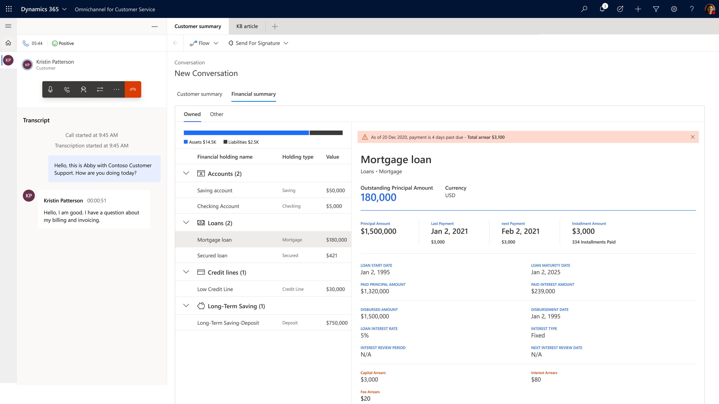
Banking customer engagement
Help personalize customer interactions with relevant financial information to accelerate time to resolution
Engage customers in their preferred channel
Benefit from consistent, connected experiences across channels including voice, chat, SMS, Facebook Messenger, WhatsApp, WeChat, Twitter DM, and Line – all from a unified agent desktop
Automate self-service with virtual agents and rich knowledge-base portals via Power Virtual Agent
Leverage experts on the fly
Use Microsoft Teams to help agents connect with subject-matter experts and resolve complex cases quickly, regardless of their job function or location
Reference relevant resources quickly with AI-powered suggestions that use real-time context cues to recommend similar knowledge articles or cases
Public preview edition
Dependencies: Dynamics 365 Customer Service with Omnichannel | Recommended: Dynamics 365 Customer Insights
Notes:
Slide title: Banking customer engagement
Engage customers in their preferred channel
Benefit from consistent, connected experiences across channels including voice, chat, SMS, Facebook Messenger, WhatsApp, WeChat, Twitter DM, and Line – all from a unified agent desktop
Automate self-service with virtual agents and rich knowledge-base portals via Power Virtual Agent
Leverage experts on the fly
Use Microsoft Teams to help agents connect with subject-matter experts and resolve complex cases quickly, regardless of their job function or location
Reference relevant resources quickly with AI-powered suggestions that use real-time context cues to recommend similar knowledge articles or cases
<click>

Slide 22
Banking customer engagement
Reference architecture
Banking Customer Engagement
D365 Customer Insights
D365 Customer
Engagement
Omnichannel
Customer intelligence
Financial Services Segments
Financial Services Models (Financial Services Churn)
Financial Services Measures
Power Apps
Core Retail Banking Controls
Customer snapshot
Life events
Financial holdings
Dataverse
Financial Services Core Retail Banking Plugins
Financial Services CI Entities
Key
CI Data Store
Industry Data Model
Microsoft products
Financial services common DM
Retail Banking Entities
Common Data Model
Capability components
Bank Environment
Bank environment
Bank Schema 2 Financial Services CDM
Non-Customer Experience optional data
Customer Experience data (CIF+)
Additional Bank data sources
Banking Core Compute
Notes:
Slide title: Banking customer engagement
[Seller guidance: Walk through the architecture starting at the bottom and answer any questions the customer has.]
<click>

Slide 23
The capabilities connect for a unified journey
Customer onboarding
Banking customer engagement
Unified customer
profile
Collaboration manager
Notes:
Slide title: The capabilities connect for a unified journey
Those are our 4 key capabilities for improving customer and employee experience
First, unified customer profile helps banks to personalize and make better offers
When customers respond to these offers, Customer onboarding helps simplify and accelerate the process
Collaboration manager then helps employees partner together and share information to address customer interest more efficiently
And Banking customer engagement helps keep customers informed and supports them during servicing
You can mix and match these capabilities to create scenarios that are relevant to your business. No matter which you choose to leverage, they work together to help create a unified journey for both your employees and your customers.
<click>

Slide 24
Combatting financial crime
“Next-gen tech can increase productivity in financial crime operations by 30-75%. These are significant numbers as global spending on AML and fraud operations is estimated at $31.6B for 2020.”
— Neil Katkov, PhD
Head of Risk and Compliance, Celent
Notes:
Slide title: Combatting financial crime
Financial crime can mean a hit to a bank’s reputation and credibility. The Cloud for Financial Services provides capabilities to help combat it.
<click>
Source: IT and Operational Spending in AML-KYC: 2020 Edition - December 1 2020 (Celent) https://www.celent.com/insights/587134172

Slide 25
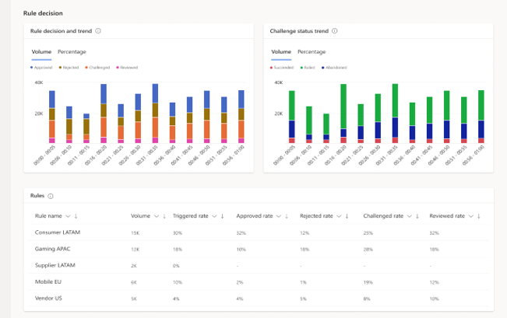
Account protection
Help prevent fraudulent digital account creation and account takeover
Risk assessment and bot protection
Take advantage of these two key services in a single solution
Simple integration
An API within this SaaS solutions helps you easily integrate with your existing systems
Built-in compliance
Leverage an approach built for compliance with encryption of data in transit and at rest
Notes:
Slide title: Account protection
We offer integrated account and purchase protection capabilities that enhance customer experience, lower account fraud, and boost profitability.
First, let me tell you about Account Protection:
This provides protection at the digital identity account layer, helping to identify and prevent fraud at digital account creation (ie., stop bad actors from creating digital accounts) and at digital account login.
This solution rolls together risk assessment and bot protection, so you have everything in one place rather than point solutions.
What’s more, account protection is very simple to integrate with your existing systems, helping to reduce time and effort.
Finally, our solution is built for compliance. Data is encrypted in transit and at rest and de-identified on its way into the network.
<click>
[Note: This capability is a subset of Dynamics Fraud Protection.]

Slide 26
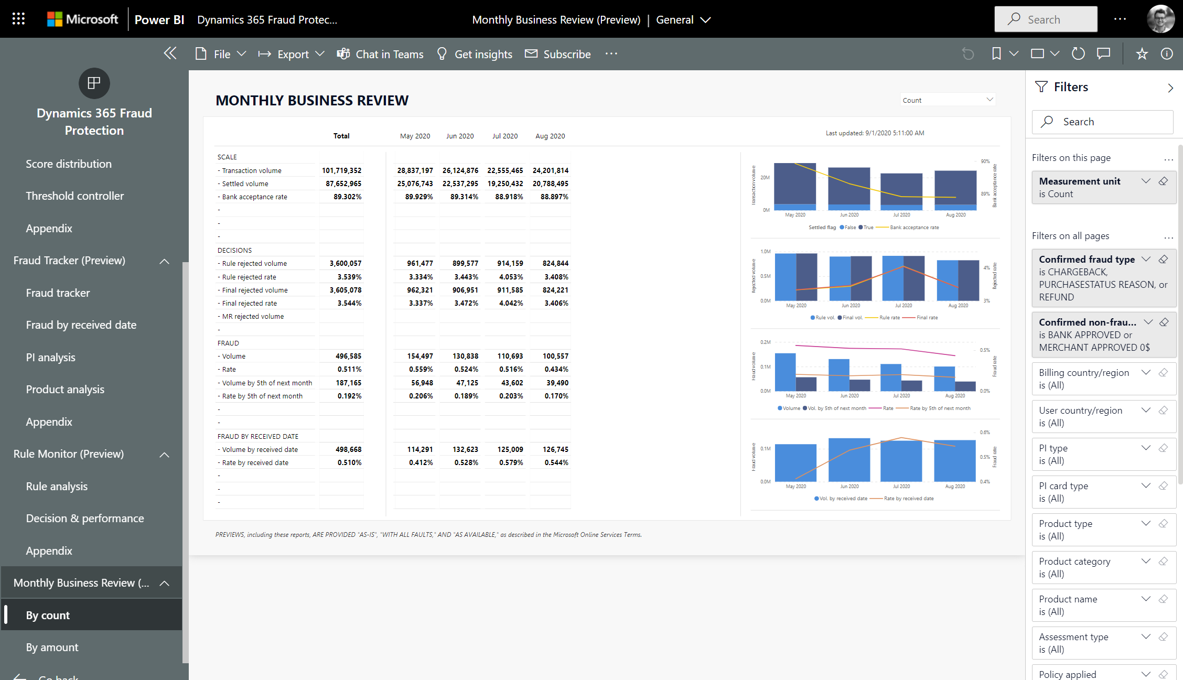
Purchase protection
Help provide a differentiated experience for merchants to improve revenue and retention
Balanced approach
Help reduce loss and decrease false positives to improve merchant profitability
Transaction acceptance booster
Stream live data to your card authorization engine to help authorize more legitimate transactions
Customer value
Help manage fraud for your customers at scale as a service
Notes:
Slide title: Purchase protection
In addition, we offer purchase protection capabilities which help provide a differentiated experience for merchants to improve revenue and retention:
A hallmark of purchase protection is our balanced approach. Unlike other vendors, we focus not only on helping to reduce loss but also on decreasing false positives.
To achieve this, we offer a Transaction Acceptance Booster, which helps authorize more legitimate transactions by streaming real-time risk data to your card authorization engine.
Next, we help increase value for your customers. You can offer effective fraud protection as a service to your customers at scale, helping to increase your profitability and customer satisfaction.
What makes our solution so effective?:
Most vendors in this space have separate account protection and purchase protection solutions. Our solutions work together through a fraud protection network that breaks down data silos, helping to enable much more effective protection.
In addition, our tools are already being leveraged by some of the world’s largest companies. We developed these tools in-house to address our own account and purchase protection needs and offer to you these industry-leading tools which we trust for our own business.
Finally, you can take advantage of our global risk assessment. You’re no longer just looking at potential risk from within your own population of users. Rather, our Fraud Protection Network pulls data from all our customers, including Microsoft itself, in a highly secure, compliant, de-identified way. It then computes global risk across all our customers using machine learning trained on this highly diverse, large dataset.
<click>
[Note: This capability is a subset of Dynamics Fraud Protection.]

Slide 27
Security and compliance
“We do not compromise on data privacy. Against that background, the security and compliance functions of Azure were convincing, which is why we chose Microsoft as our competent cloud provider.”
— Lutz Küderli
Head of Underwriting, Claims, Digital Services and Insurance Medicine (Europe/LATAM) for Life & Health at Munich Re
Notes:
Slide title: Security and compliance
Finally, I’d like to talk about our security and compliance capabilities.
<click>

Slide 28
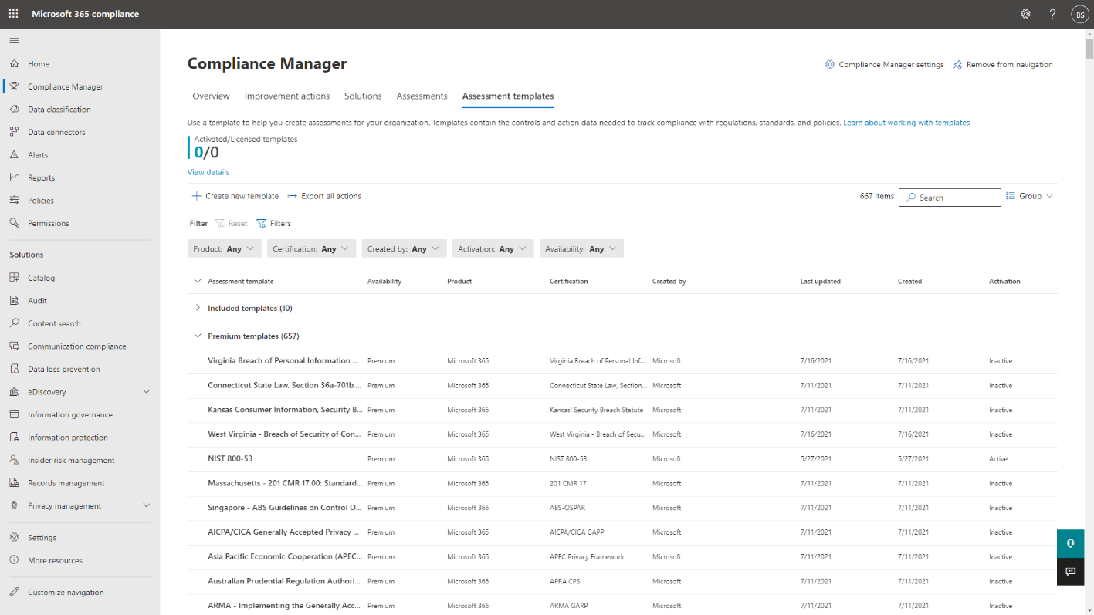
Regulatory compliance assessments
Assess, monitor, and help improve compliance posture with global, regional, and industry regulations and standards
Cloud risk assessments
Help accelerate your Microsoft cloud and vendor-related risks assessments
Industry standards
Leverage 40+ pre-built assessments for standards and regulations such as GDPR
Compliance posture
Help improve your overall compliance posture, enhancing security and privacy controls
Notes:
Slide title: Regulatory compliance assessments
Our regulatory compliance assessments enable you to assess, monitor, and help improve compliance posture with global, regional, and industry regulations and standards
This capability provides the following:
Speed up cloud risk assessments: Help accelerate your Microsoft cloud and vendor-related risks assessments
Align with industry standards: Leverage 40+ pre-built assessments for standards and regulations such as GDPR
Optimize for better compliance: Help improve your overall compliance posture, enhancing security and privacy controls
<click>
[Note: This capability describes Microsoft Compliance Manager.]

Slide 29
Risk assurance and support
Leverage white glove service to support risk, audit, and compliance teams with regulatory compliance, security, and privacy
Compliance Summit and Community
Connect with Microsoft Leadership on compliance topics and engage directly with peers and regulators in industry
Ask an expert
Support risk stakeholders to accelerate their assessments and approval cycles
Financial Services Compliance Program
Proactive risk assurance
Stay up to date on important regulatory changes and explore walk-throughs of curated audit artifacts
Concierge and learning paths
Upskill on cloud risk assessment and navigate our rich set of resources
Notes:
Slide title: Risk assurance and support
Microsoft has a track record of nearly 10 years of deep engagements with worldwide regulators and customers addressing regulatory compliance topics that are of strategic importance to the industry.
Our compliance program provides customers with a white glove service delivered through a dedicated team of industry, engineering, and legal and corporate affairs subject matter experts that broadly support your risks, audit, and compliance teams in addressing financial services regulatory compliance, cybersecurity, and privacy topics. The program both offers strategic support on how to best address regulatory challenges as well as helps to address any related topics in the greatest level of detail.
The program features:
Compliance Summit and Community: Engage and learn from peers in the industry as well as discuss directly with regulators trending issues around the use of cloud. We built a deep and trusted relationship with financial services regulators and have been organizing compliance summits with Microsoft leadership, regulators, and customers for 9 years. Through summits, webinars and other events you have an exclusive opportunity to engage directly with your peers in the industry as well as with regulators from over 50 countries worldwide.
Ask an expert: Support risk stakeholders including cybersecurity, legal, compliance, operational risk and audit to accelerate their assessment and approval cycles around the use of Microsoft cloud services. Engage directly with Microsoft subject matter experts and get the best possible answers to compliance questions in great detail. Quickly identify the right documentation resource with their help. And submit risk assessments questionnaires to a team of Microsoft experts as needed.
Proactive risk assurance: Stay updated on regulatory changes and important changes to our Online Services. This includes walk-throughs of curated audit artifacts and sharing outcomes from audits.
Concierge and learning paths: Upskill on cloud risk assessment and navigate our rich set of documentation resources and compliance tools.
In the past 8 years, we’ve engaged over 120 financial services regulators, and over 150 customers are enrolled in this program.
<click>
[Note: This capability describes Financial Services Compliance Program.]

Slide 30
Microsoft Cloud for Financial Services
Core financial services systems
Security and Compliance
Combat Financial Crime
Deliver Differentiated Customer Experience and Empower Employees
Platform Extensibility
Regulatory compliance assessments
Account protection
Unified customer profile
Collaboration manager
Customer onboarding
Banking customer engagement
Compliance Manager
D365 Fraud Protection
Unified customer profile
Power Apps
D365 Customer Insights
Collaboration manager
Power Apps
SharePoint
Microsoft Bookings
Teams
Loan tracker
Power Apps
Banking customer engagement**
D365 Customer Service
D365 Omnichannel for Customer Service
Chat for D365
D365 Customer Voice
D365 Customer Insights
ISV and SI Solutions
Retail banking sample portal
Power Apps portals
Purchase protection
Risk assurance and support
D365 Fraud Protection
Dynamics 365 Microsoft 365
Financial Services Compliance Program
Power Platform
Microsoft Azure
Industry data model
Industry-relevant security and compliance
Industry priority scenarios
Microsoft Cloud for Financial Services Capabilities
Microsoft core technology
Third party
** Public Preview at GA
Notes:
Guidance
Setup
*Should always follow Wheel – unwrap details to explain pieces more fully and answer the question “What is the Cloud for Financial Services?”
Ground Cloud for FS in technology, how MS comes together to deliver what is represented in wheel
The slide is engineering-validated to confirm that the products represented are, in fact, included in the packaging under each capability
Please do NOT use this slide for these purposes
Not intended for discussion around what a customer has to buy. Every customer is different, refer to business planning assets for those discussions
Not intended for deep per-capability architecture discussion, refer to capability architectures for that
Goal of this Slide
This slide
represents which MS products come together to address industry prioritized scenarios (for retail banking for now) through the Cloud for FS
- note that Industry Prioritized Scenarios may be removed if preferred
reflects required and recommended capabilities/pieces to deploy the Cloud for FS
highlights the differentiated aspects of the Cloud for FS that drive customer value
indicates 3rd party extensions – opportunity for lead-in to partner conversations (can note that MS is not/will not be a core banking solution)
Partner solutions
connect to same Microsoft core technologies and retail banking data model
ISV partnerships adhere to same security and compliance certification as our first party capabilities
capabilities may integrate with existing third party core banking solutions
reflect extensibility points for customers into their own proprietary or planned technical solutions
Slide structure
Dark blue – core MS cloud stack
Medium blue – what makes this industry cloud special/unique, differentiated aspects
Purple – where ISV and SI partnerships connect
Cloud for FS Microsoft and partner capabilities/applications sit atop MS core technology, retail banking data model, consistent security and compliance requirements, and may integrate with third party bank customer core banking solutions
Structure above the retail banking data model represents interoperability on common platform/baseline, enabling customers to derive insights and run applications that work with each other in real time to support consumer and employee needs
Security and Compliance solutions on left offer unique value prop to address industry needs

Slide 31
Industry standards and certifications
Industry
Regional
We have the extensive compliance coverage in the industry with 90+ compliance offerings
Global
US Gov
CIS Benchmark
CSA STAR Attestation
CSA STAR Certification
CSA STAR self-assessment
ISO 27001:2013
ISO 27017:2015
ISO 27018:2014
ISO 22301:2012
SOC 1 Type 2
SOC 2 Type 2
SOC 3
ISO/IEC 27701:2019
ISO 9001:2015
ISO 20000-1:2011
WCAG 2.0 (ISO 40500:2012)
European Banking Authority (EBA)
FFIEC (US)
OSFI (Canada)
PCI DSS Level 1
SEC 17a-4 (US)
European Securities and Markets Authority (ESMA)
European Insurance and Occupational Pensions Authority (EIOPA)
GLBA (US)
Shared assessments (US)
CFTC 1.31 (US)
FINRA 4511 (US)
SOX (US)
23 NYCRR 500 (US)
FCA + PRA (UK)
APRA (Australia)
FINMA (Switzerland)
FSA (Denmark)
RBI + IRDAI (India)
MAS + ABS (Singapore)
K-ISMS
KNF (Poland)
FISC (Japan)
HIPAA BAA (US)
HITRUST certification
GxP (FDA 21 CFR Part 11)
MARS-E (US)
FERPA (US)
CDSA
MPAA (US)
FACT (UK)
DPP (UK)
TISAX (Germany)
NERC
GSMA
California Consumer Privacy Act (CCPA)
GDPR
Germany C5
European Standard Contractual Clauses (SCC)
Argentina PDPA
Australia IRAP Unclassified
Australia IRAP PROTECTED
Canada Privacy Laws
China GB 18030:2005
China DJCP (MLPS) Level 3
China TRUCS/CCCPPF
EU EN 301 549
EU ENISA IAF
Germany IT— Grundschutz workbook
India MeitY
Japan CS mark gold
Japan my number act
Netherlands BIR 2012
New Zealand Gov CIO Framework
Singapore MTCS Level 3
UK cyber essentials plus
UK G-Cloud
UK PASF
FedRAMP high
FIPS 140-2
NIST CSF
FedRAMP moderate
CNSSI 1253
CJIS
DFARS
DoE 10 CFR Part 810
EAR
IRS 1075
ITAR
NIST SP 800-171
Section 508 VPATs
DoD DISA SRG Level 5
DoD DISA SRG Level 4
DoD DISA SRG Level 2
Note: Certifications in blue are specific to financial services
For additional compliance resources, see the full list of compliance offerings and compliance guides
Notes:
Slide title: Industry standards and certifications
Microsoft offers extensive compliance coverage in the industry with 90+ compliance offerings spanning global, industry, regional, and government needs.
See https://aka.ms/AzureCompliance for more information.
<click>

Slide 32






Microsoft Cloud for Financial Services Strengths
Business model alignment
Customer ownership and control of data
Trusted, global security commitment
Industry customization
Robust partner ecosystem
32
Notes:
Slide title: Microsoft Cloud for Financial Service strengths
So, what makes Microsoft Cloud for Financial Services unique?:
First, trust in business model alignment. No one wants to be dependent on a provider that sells them technology on one end and competes with them on the other. Microsoft will always be a trusted adviser, a co-innovator and a partner.
Second, your data belongs to you, not to us. We work with you to help you harness the data to build the predictive and analytical power required for your own competitive advantage.
Third, empowerment begins with trust. To create a safer world empowered by digital transformation, we adhere to industry security and privacy standards to in turn enable you to manage your data footprint and create your own governance.
Fourth, we recognize every industry is unique. Our aim is to deliver solutions tailored to their specific needs. We listen deeply to you and employ experts who bring industry perspective to all stages of our product development, as well as our customer engagement. Additionally, the capabilities are composable - you can start where you are and integrate new capabilities from the Microsoft Cloud for Financial Services.
Finally, our offerings can be customized by a global ecosystem of trusted partners. We work with leading ISVs and system integrators, so you have the complete solutions you need to address your unique business challenges.
<click>

Slide 33




Thank you
Microsoft Cloud for Financial Services
Notes:
Slide title: Thank you

Slide 34
Today, priorities are changing, and technology needs to keep up
Financial services organizations are focused on:
But their technology is holding them back:
Enhancing resilience
Data access challenges
95%
of insurance leaders say they are accelerating or looking to speed up digital transformation to improve resilience¹
600
Global financial services organizations report having up to 600 different internal data repositories³
Enabling digital collaboration
Security concerns
$30B
Streamlining core business processes with enhanced digital collaboration could generate $30B in business value²
83%
of leaders at US banks say cybersecurity is their top risk concern⁴
1. Deloitte 2. McKinsey 3. McKinsey 4. Moss Adams
Notes:
With the pandemic and other disruptions in the industry, banks’ priorities are shifting.
Today financial services organizations are focused on:
Enhancing client experience: With the pandemic driving so much disruption in the industry, financial services organizations are looking for ways to enhance resilience. For instance, in the insurance realm, 95% of leaders say they are accelerating or looking to accelerate digital transformation to drive greater resilience.
Enabling digital collaboration: Financial services organizations also recognize that digital collaboration could unlock significant value creation. According to McKinsey, “assuming that core business processes which represent 15 to 20 percent of spending could be streamlined to improve productivity by 8 to 10 percent (e.g., eliminating unneeded back-and-forth), the result of scaling up to the entire global banking industry might generate new value of $30 billion or more.”
But financial services organizations are finding that their technology is holding them back.
Data access challenges: They are often saddled with dozens or even hundreds of data silos that prevent them from, for example, creating unified customer profiles that could enable personalization to enhance the customer experience. In fact, global organizations report having up to 600 different internal data repositories
Security concerns: Security concerns create additional complexity in addressing banks’ new priorities. 83% of leaders at US banks say cybersecurity is their top risk concern.
It’s no wonder banks are struggling to meet their evolving priorities. Fortunately, these barriers are not insurmountable.
<click>

Slide 35
Unified customer profile
Reference architecture
Unified customer profile
D365 Customer Insights
Power Apps
Unified customer profile app
Banking Customer Intelligence
Financial Services Segments
Financial Services Models (Financial Services Churn)
Financial Services Measures
Core Retail Banking Controls
Customer snapshot
Connections (Groups & Relationships)
Life events
Financial holdings
Dataverse
Financial Services Core Retail Banking Plugins
Financial Services CI Entities
Key
CI Data Store
Industry Data Model
Microsoft products
Financial services common DM
Retail Banking Entities
Common Data Model
Capability components
Bank Environment
Bank environment
Bank Schema 2 Financial Services CDM
Non-Customer Experience optional data
Customer Experience data (CIF+)
Additional Bank data sources
Banking Core Compute
Notes:
Slide title: Unified customer profile
[Seller guidance: Walk through the architecture starting at the bottom and answer any questions the customer has.]
<click>

Slide 36
Customer onboarding
Reference architecture
Customer Onboarding
Key
Power Automate
Power Apps
Loan Tracker Application
Microsoft products
Auto Archiving
Customer Onboarding Controls
Application snapshot
Loan parties' details verification
Financial strength snapshot / assets & liabilities view
Loan application document management
Capability components
Bank environment
Dataverse
Loan Application Plugins
Loan Application Business Process
Loan Application Management Logic
Document Rule Engine
Loan onboarding DM
C2 Customer
Financial Services Common DM
Note: Customer onboarding includes an optional sample portal powered by Power Portal to showcase how C2 can interact with the system
Common Data Model
Bank Environment
Bank Schema 2 FSI CDM
Customer Experience data (CIF+)
Banking Core Compute
Notes:
Slide title: Customer onboarding
[Seller guidance: Walk through the architecture starting at the bottom and answer any questions the customer has.]
<click>

Slide 37
Collaboration manager
First-party
Microsoft Teams
Reference architecture
Collaboration Manager (Model Driven App)
Microsoft Dataverse
Industry Toolkit
Banking Data Model
Microsoft Graph
Partner
Integration service
Connectors
Customer
System of Record
Public preview edition
Key
Teams
Partner
Customer
Notes:
Slide title: Collaboration manager
[Seller guidance: Note - Dynamics 365 applications sit at the integration service level or sometimes the system of record itself. Integration with Customer Onboarding is possible through this integration service.]
<click>

Slide 38
Banking customer engagement
Reference architecture
Banking Customer Engagement
D365 Customer Insights
D365 Customer
Engagement
Omnichannel
Customer intelligence
Financial Services Segments
Financial Services Models (Financial Services Churn)
Financial Services Measures
Power Apps
Core Retail Banking Controls
Customer snapshot
Life events
Financial holdings
Dataverse
Financial Services Core Retail Banking Plugins
Financial Services CI Entities
Key
CI Data Store
Industry Data Model
Microsoft products
Financial services common DM
Retail Banking Entities
Common Data Model
Capability components
Bank Environment
Bank environment
Bank Schema 2 Financial Services CDM
Non-Customer Experience optional data
Customer Experience data (CIF+)
Additional Bank data sources
Banking Core Compute
Notes:
Slide title: Banking customer engagement
[Seller guidance: Walk through the architecture starting at the bottom and answer any questions the customer has.]
<click>

Slide 39
Banking customer engagement
Reference architecture
Banking Customer Engagement
D365 Customer Insights
D365 Customer
Engagement
Omnichannel
Customer intelligence
Financial Services Segments
Financial Services Models (Financial Services Churn)
Financial Services Measures
Power Apps
Core Retail Banking Controls
Customer snapshot
Life events
Financial holdings
Dataverse
Financial Services Core Retail Banking Plugins
Financial Services CI Entities
Key
CI Data Store
Industry Data Model
Microsoft products
Financial services common DM
Retail Banking Entities
Common Data Model
Capability components
Bank Environment
Bank environment
Bank Schema 2 Financial Services CDM
Non-Customer Experience optional data
Customer Experience data (CIF+)
Additional Bank data sources
Banking Core Compute
Notes:
Slide title: Banking customer engagement
[Seller guidance: Walk through the architecture starting at the bottom and answer any questions the customer has.]
<click>

Slide 40


Financial services regulatory compliance
Take advantage of integrated compliance tools specifically designed for financial services
Regulatory compliance checklists for key markets
In-region data storage and multi-geo capabilities
Information barriers
WORM storage, surveillance, and SEC 17a-4 compliance
Payment Card Industry compliance (PCI DSS)
eDiscovery, investigations support, and audit logging
Notes:
Slide title: Financial services regulatory compliance
[Seller guidance: this slide highlights the compliance tools specific for financial services. See additional information below. If you prefer to have more information on the slide, there’s an alternate version of this slide in the appendix]
Microsoft offers integrated compliance tools specifically designed for financial services, including:
Regulatory compliance checklists for key markets
In-region data storage and multi-geo capabilities
WORM storage, surveillance, and SEC 17a-4 compliance
eDiscovery, investigations support, and audit logging
Payment Card Industry compliance (PCI DSS)
Information barriers
<click>
More information:
Leverage regulatory compliance checklists to help ensure your cloud services meet the applicable regulatory requirements across all your regions.
In-region data storage and multi-geo capabilities empower you to provision and store data at rest in the geo locations that you've chosen to meet data residency requirements
Microsoft 365 includes archiving features that enable regulated customers, including broker-dealers, to store data in a manner that helps them comply with SEC 17a-4 requirements for records retention
Enhance compliance with built-in tools for in-cloud data preservation, eDiscovery, investigations support and audit logging. Search for content across your applications and identify, hold, and export content in line with regulatory expectations
Azure, OneDrive for Business, and SharePoint Online are certified as compliant under PCI DSS version 3.2 at Service Provider Level 1 (the highest volume of transactions, more than 6 million a year)
Information barriers enable administrators to restrict communication and collaboration among specific groups of users when necessary, to avoid conflicts of interest within your organization

Slide 41










Relationship Manager
Relationship Manager
Customer Service Agent
Customer
Customer
Loan Specialist
Relationship Manager
Loan Specialist
Unified Customer Profile
Banking Customer Engagement
Customer onboarding
Collaboration manager
Power Apps
Customer Retail Banking Controls
Customer snapshot
Connections
Life Events
Financial Holdings
Dynamics 365 Omnichannel for Customer Service
Sample Power Apps Portal
Microsoft Teams
Loan tracker app
Power Apps
Collaboration Manager – Model Driven App
Power Apps
Customer Retail Banking Controls
Customer snapshot
Life Events
Financial Holdings
Power Apps
Application snapshot & verification
Financial strength snapshot
Loan Application doc management
Collaboration PCF controls
Dynamics 365 Customer Insights
Dataverse
Loan Application Plugins
Loan Application Business Process
Collaboration Toolkit DM
Microsoft Graph
Customer Intelligence
FSI Segments
FSI Models (FSI Churn)
FSI Measures
FSI Core Retail Banking Plugins
FSI CI Entities
Loan Application Mgmt Logic
Document Rule Engine
Key
Microsoft 365
Microsoft Cloud for Financial Services
CI Data Store and Retail Banking Entities
Retail Banking Core Data Model
Loan Onboarding Data Model
Planner
Bookings
SharePoint
Outlook
Microsoft Product
Banking Environment
Financial Services Common Data Model
Customization
✦✦
Bank Schema 2 FSI CDM
Non-Customer Experience optional data
Customer Experience data (CIF+)
Additional Bank Data Sources
Banking Core Compute

